Slide 1
DCT - Patient Experience
Date: 22-Dec-2021

Slide 2


Meet Anne
DATE OF BIRTH: May 31, 1955
HEIGHT: 153 CM
WEIGHT: 62.5 KG
HEALTH HISTORY
Diabetes
High blood pressure
Fatigue
MEDICATIONS
Amoxicillin
Lyrica
Advil
Targin
Prednisone
Notes:
But really behind all the policies, statistics, and strategies are people and their situations
This is Anne. Anne is a 66 year old retired school teacher that is active in the community. While active, she has a history of diabetes, high blood pressure and has been increasingly feeling fatigued.

Slide 3





Anne’s Journey
Discharge
New prescriptions and ‘education’
Unable to fill some prescriptions
Diagnosed with ‘Congestive Heart Failure’
Unable to follow treatment and dietary instructions
Acute medical intervention &
admitted
Lose hope and defaults on medications
911 - ED
Unable to monitor symptoms worsening
Shortness of breath
Unwell again, calls 911 and back to ED
Re-Admitted - Acute decompensated heart failure
22 days
Notes:
After experiencing shortness of breath while gardening, Anne goes to the hospital emergency department (ED) and is admitted with a congestive heart failure diagnosis. Anne is prescribed medication and discharged. In the weeks that follow however, Anne is unable to follow treatment and dietary instructions and again suffers from worsening symptoms and is readmitted to the hospital.

Slide 4
Considering Participation in Clinical Research
CHF Home Telemonitoring: A Home Telemonitoring Service for Chronic Heart Failure Patients
Study Design
Allocation | Randomized
Duration | 6 months
Primary Purpose | Prevention
Objective | Reduce Heart Failure Related Hospital Readmissions Additional costs/savings resulting from the service
Intervention (Home Telemonitoring)
Daily monitoring the patients' weight and blood pressure directly from their home; automatically and securely transmit the values to a server at the hospital; and monitor the values by a trained nurse at the Heart polyclinic
Study Participation Criteria
Inclusion | Presence of CHF signs and symptoms ( [NYHA] functional class II-IV); and ejection fraction (EF) under 40%, according to the American College of Cardiology/American Heart Association Guidelines for chronic heart failure.
Exclusion Criteria: | Severe psychiatric disturbance. Any disability that may prevent the subject from completing the informed consent form or other study requirements. Medication or drug dependency or abuse (except for nicotine). Inability to handle the technological devices included in the study, for some other reason.
Notes:
Anne’s physician happens to be an investigator for a clinical trial evaluating telemonitoring services to reduce heart failure related hospital readmissions and recommends Anne consider joining the study to help
https://clinicaltrials.gov/ct2/show/study/NCT02489370

Slide 5
Enabling Decentralized Clinical Trial for CHF

Slide 6

DCT – Patient Experience
All Trials
2
CDR
Dashboard
My Trials
Task 1
Task n
Trials Details
Trials Calendar View
3
1
Login
My Devices
Device Listing
Patient
Authentication
Pair New Device
Vitals Posting
4
My Health Data
Task 1
Task n
Statistical View 1
Statistical View n
Staging Database

Slide 7
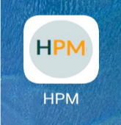
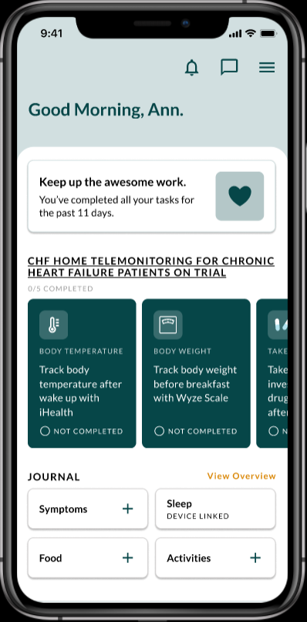
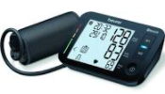






DCT - Project Architecture
HSP Platform
Cloud Foundry
CDR
PostgreSQL
Patients
Repository | Authentication
Git & AWS Commit | HSP IAM AWS Cognito
Data Repository | Medical Devices
HSP Clinical Data Repository | Beurer BM 54
Frameworks | Healthcare standard
Next js package management

Slide 8

DCT - Architecture
HSP Platform
Cloud Foundry
CDR
DCT
PostgreSQL
Blob
Notification
Patients
Repository | Authentication
Git & AWS Commit | HSP IAM AWS Cognito
Data Repository | Medical Devices
HSP Clinical Data Repository, HSP Blob | Beurer BM 54
Frameworks | Healthcare standard
Next js package management

Slide 9





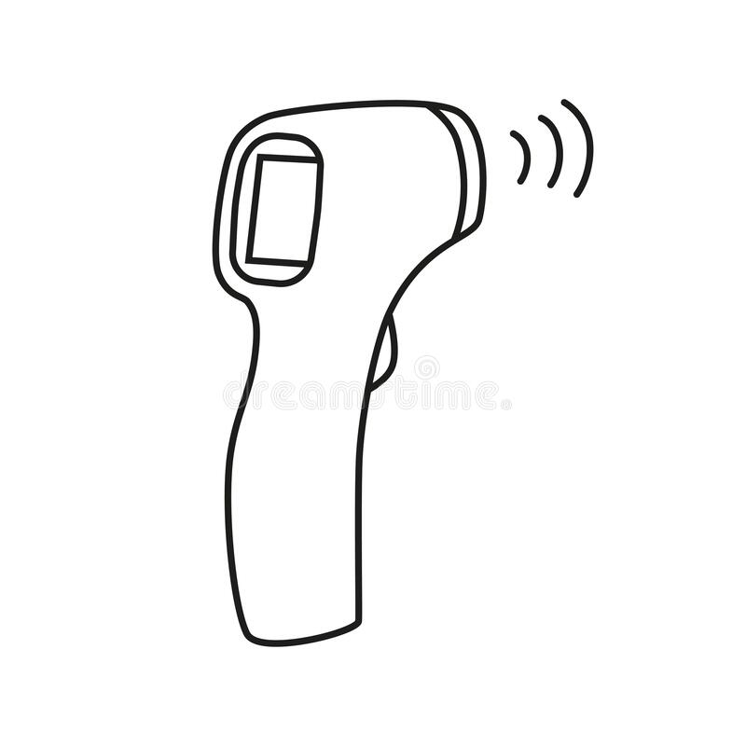

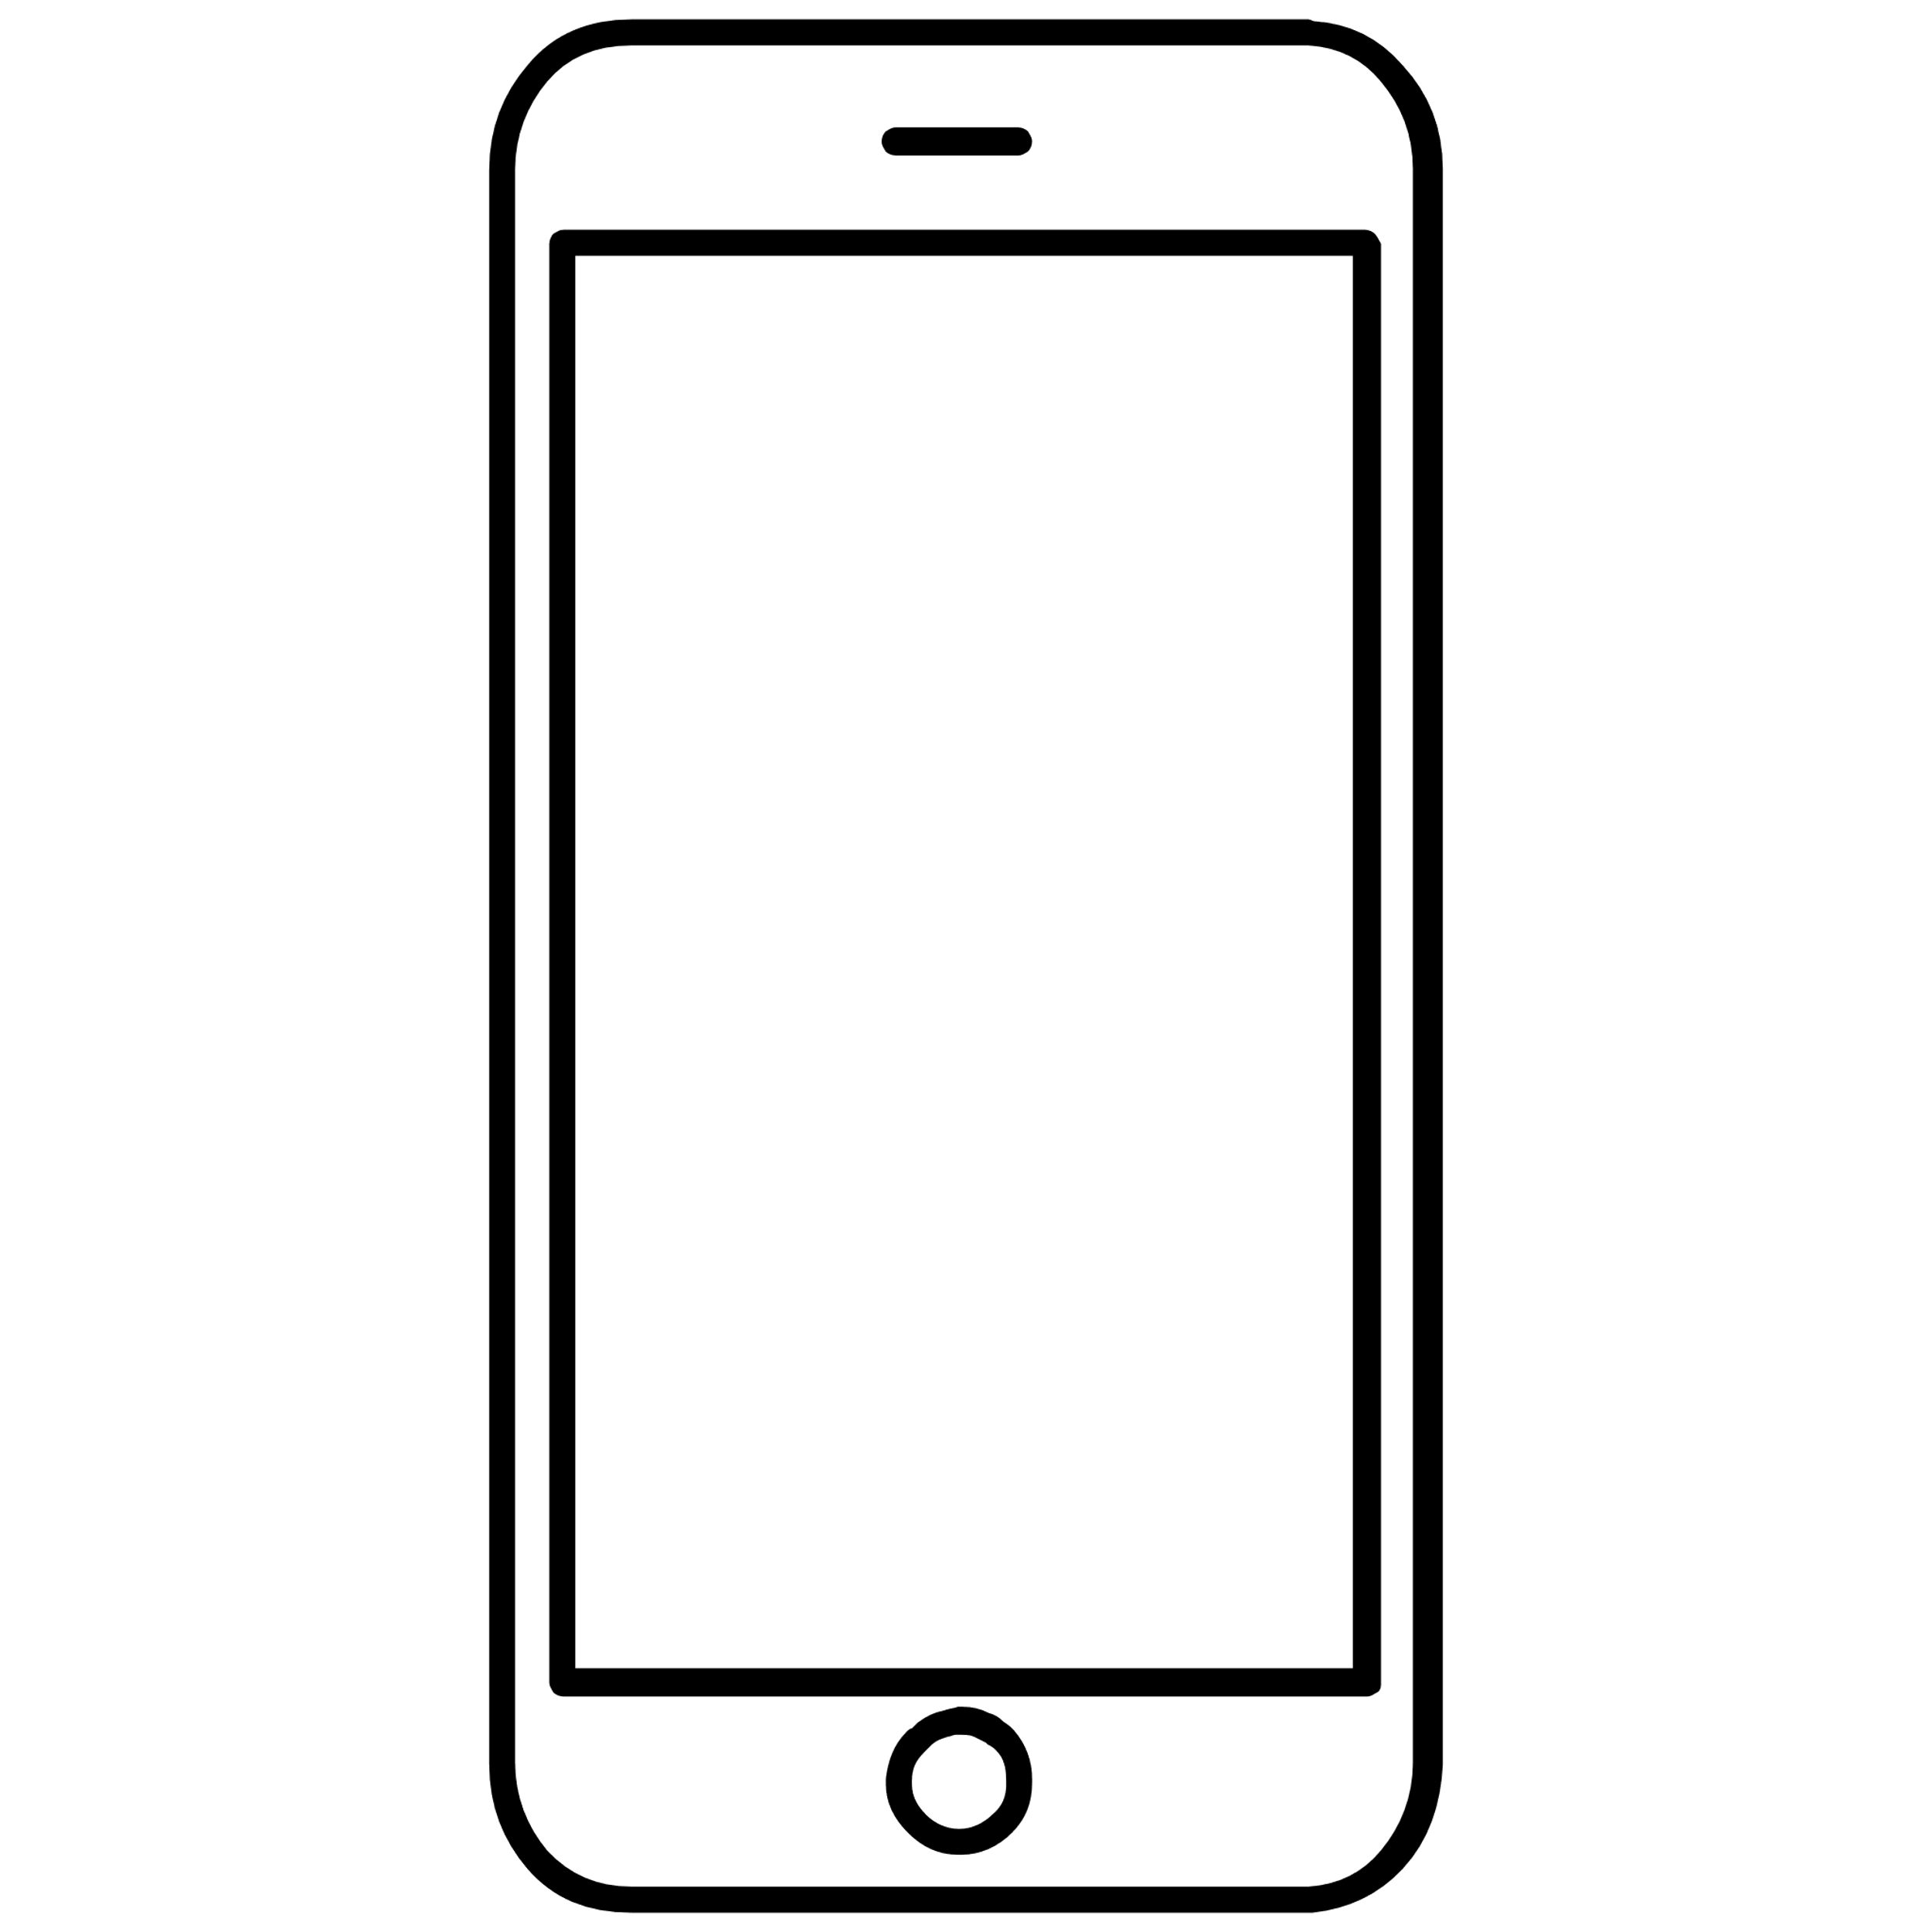

DCT - Technical Architecture
Health Suite Platform
Patient login to mobile app
Using the Access token sent Validation of the token is done.
On successful Authentication , the API Gateway is called which talks to the Amazon RDS to retrieve needed information using Lambda
Then the relevant information from CDR is retrieved after IAM Authorization.
In order to consume notifications in specific scenarios & thus needed APIs and Lambdas as called.
In order to get consent forms from the patients we store the agreements in Blob/Object Storage
Once the user is ready with the readings for the day , they push it to CDR by accessing the same application.
TDR & Connect are intended to be used for device connect & storing digital signatures.
AUTHORIZE
HOST
Identity & Access Management
6
Object
Storage
2
3
RDS Service Broker
SHARE
IO Bridge
Logging
5
Notification
Reporting
Validate
8
7
STORE
CONNECT
Patient
1
Blob
Repository
S3 Credentials
Telemetry Data Repository
Connect IoT
6
Pairing
Clinical Data Repository
Profile
Mobile App
4
Clinical Data Lake
Master Data Management
CDR – Patient, Observation, Device
RDS – User, Trials, Organization

Slide 10
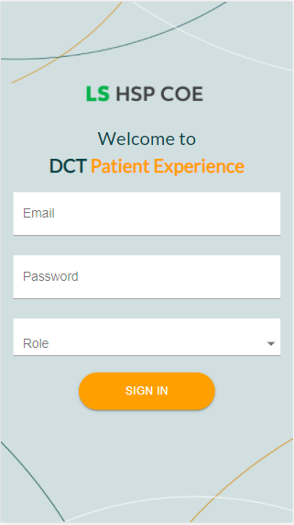
Patient Login
Patients can login to the application using their credentials by selecting the Patient role.
On successful authentication patient will be directed to Dashboard screen.

Slide 11
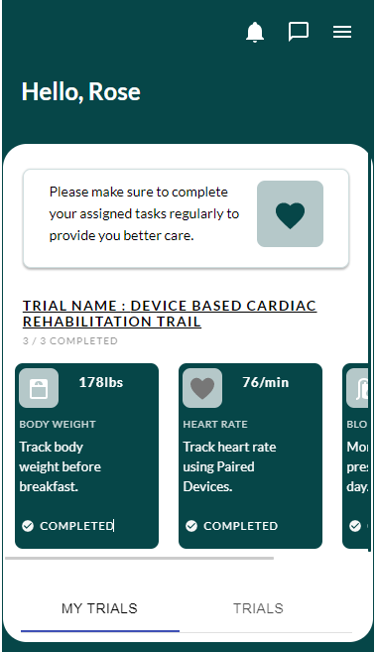
Patient Dashboard
On successful login Patient will land on Dashboard page, providing summary of associated trials and tasks status
DCT based vitals will be displayed as different cards
My Trials section will show currently assigned trials for the patient
Under Trials section patient can be find all ongoing Trials details within the organization

Slide 12
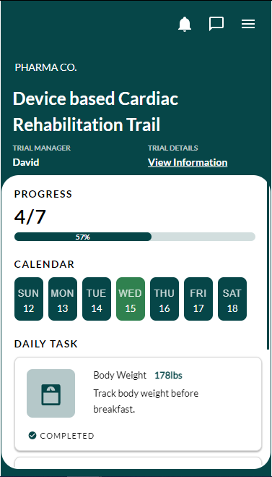
Daily Task View
Daily task view represents the progress of the tasks associated with the assigned trial and the task details for the particular day
The progress bar indicates completion of associated tasks

Slide 13
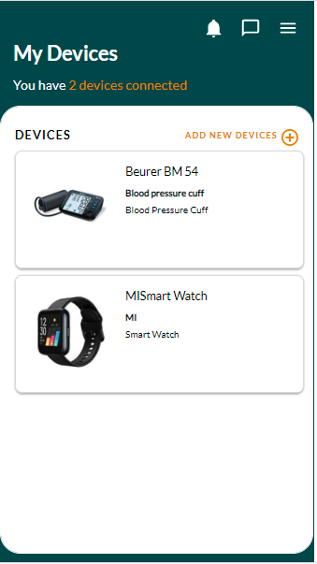
Device and Connectivity
Patient can view all paired devices which are used for capturing/completing daily tasks
Patient can add/pair a new device by adding the device details like Device Name, Manufacturer Name, Serial Number etc.

Slide 14
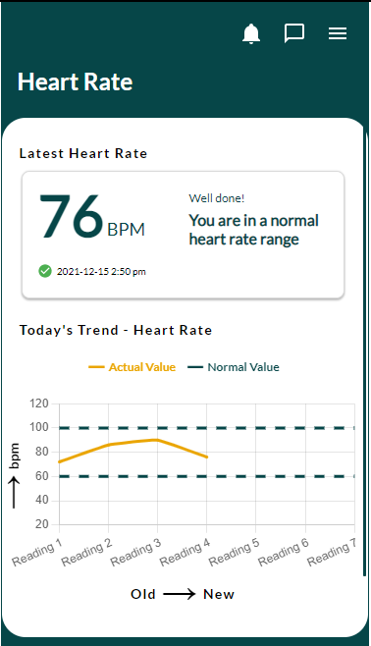
Biomarker Readings
Patient can see the actual reading values from the paired devices which were captured against the given task and can compare with the ideal/normal range values

Slide 15
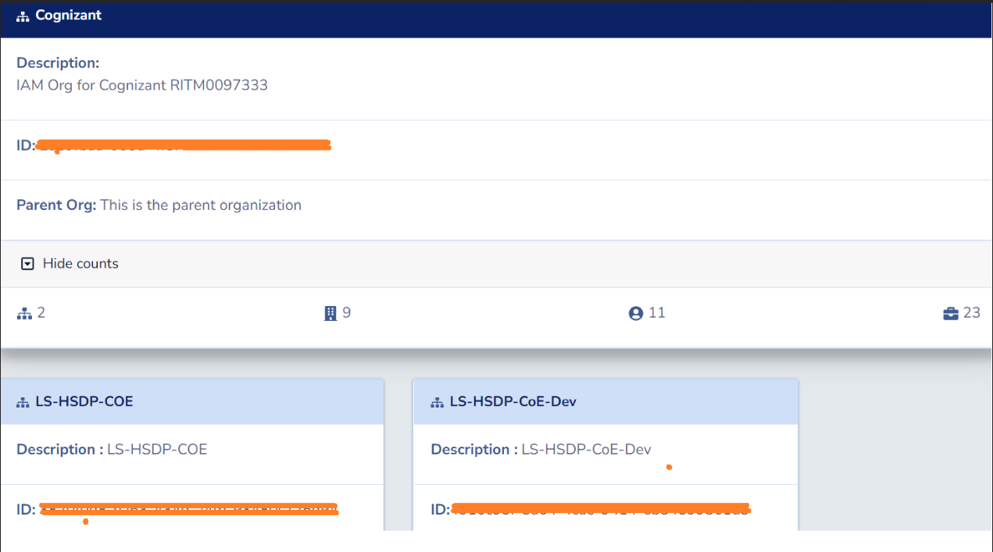
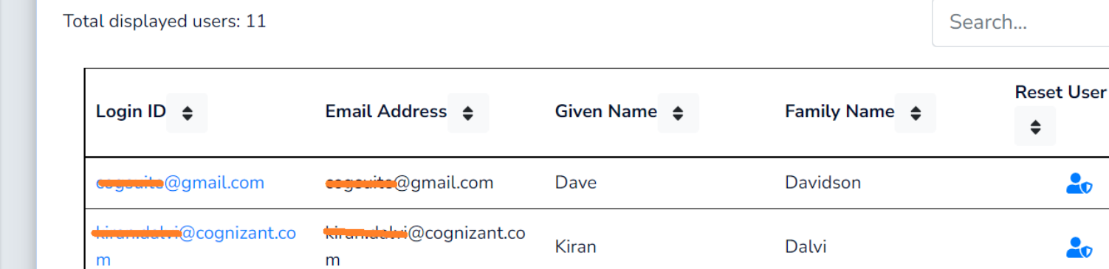
IAM Organization
For each trial site/facility, a new IAM organization will be provisioned for data privacy
All users belongs to the site will be created within this newly created organization
Roles can be created with necessary access permissions
Users/Groups can be assigned with role based permissions

Slide 16
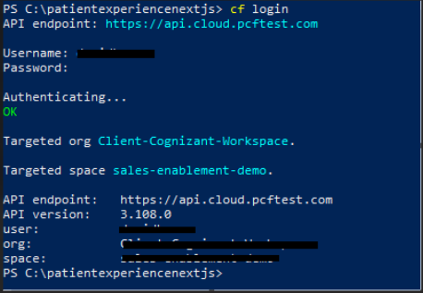
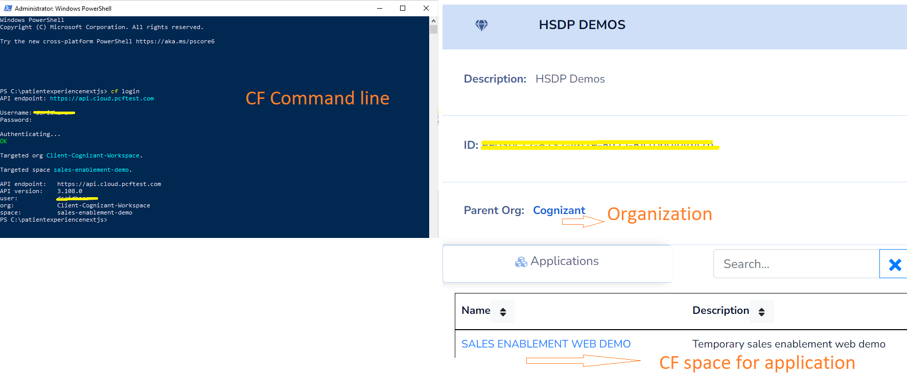
Cloud Foundry
Cloud Foundry (CF) is an enterprise cloud platform as a service (PaaS), a key underpinning technology for deploying secure applications on the HSP digital platform
CF divided into logical organizations(orgs) and spaces, separate role-based access controls can be created to grant user permissions to a specific org & spaces
CF allows developers to deploy applications and services to HSP platform

Slide 17

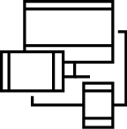
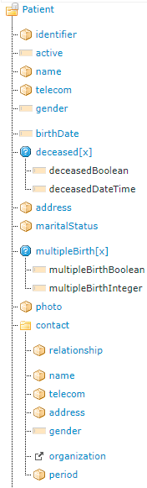
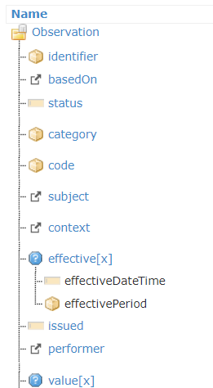
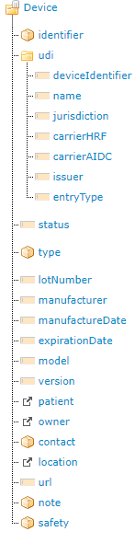
Clinical Data Repository(CDR)
Clinical Data repository acts as a cloud storage for storing the healthcare data in the FHIR format.
FHIR is a standard for health care data exchange, published by HL7®
All the patient demographics, vitals and paired device details are captured in HSP FHIR CDR using Patient, Observation and Device resources, respectively.
Patient
Observation
Device

Slide 18
Thank you

